Slide 1

Band Selection in Hyperspectral Images
Project Presentation
Group: 38
Subject Code: CS590
Subject Name: Deep Learning

Slide 2
Presented by
Aniket Agarwal* 244156013
  Department of Robotics and Artificial Intelligence
Gagan Kapoor* 255456018
  Department of Robotics and Artificial Intelligence
Shipon Nandy* 244101051
  Department of Computer Science and Engineering
  *M.Tech Student (1st Year)

Slide 3
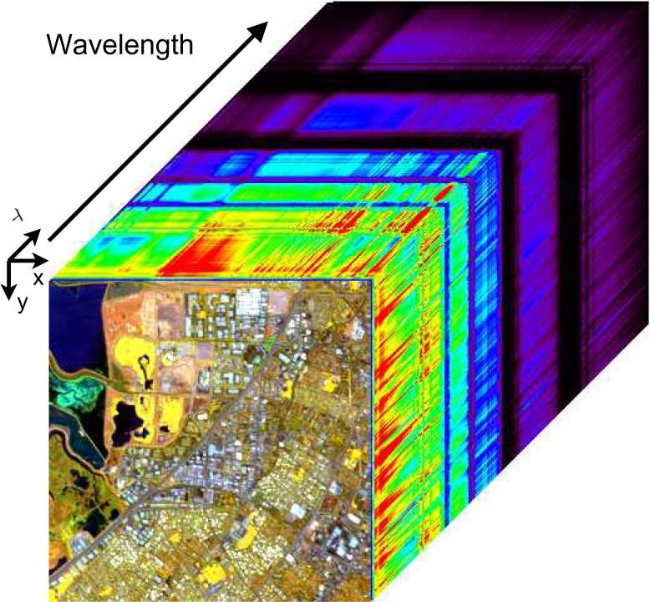
Problem Objective
The high dimensionality of hyperspectral data poses several challenges, such as increased computational costs, issues related to data storage, and the risk of overfitting during classification tasks. Additionally, the existence of redundant or irrelevant spectral bands complicates data processing and analysis, underscoring the urgent need for effective band selection methods to enhance both the efficiency and accuracy of hyperspectral data interpretation.
The goal of this project is to tackle these challenges by investigating and implementing state-of-the-art band selection algorithms derived from recent research. ​We aim to implement recently proposed methods to address the issues related to band selection in hyperspectral images.​ Additionally, we will explore potential improvements in these methods through parameter tuning and the combination of different techniques.
Figure 1: Hyperspectral Data-Cube

Slide 4
Data Description
We have used three datasets to train our models. They are given below:
  Salina Valley
    Acquired by the AVIRIS (Airborne Visible/Infrared Imaging Spectrometer) sensor over Salinas Valley, California.
  Pavia University
    Captured by the ROSIS (Reflective Optics System Imaging Spectrometer) sensor over Pavia, Italy.
  Indian Pines
    Gathered by the AVIRIS sensor over the Indian Pines test site in northwestern Indiana.

Slide 5
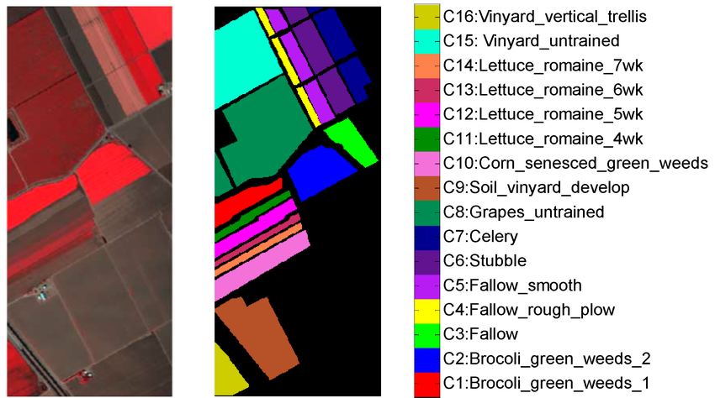
Data Description of SALINA VALLEY
Spatial Characteristics:
  Dimensions: 512 lines x 217 samples
  Spatial Resolution: 3.7 meters per pixel
Spectral Characteristics:
  Total Spectral Bands: 224
  After discarding 20 water absorption bands: 204 bands remained.
Ground Truth Information:
  Classes: 16 land cover types
Challenges:
  High dimensionality can complicate classification.
  Variability in spectral data across classes.
  Limited labeled training samples could hinder model performance.
Figure 2: Salina Valley, Original Image (left), ground truth (middle) and label category (right)

Slide 6
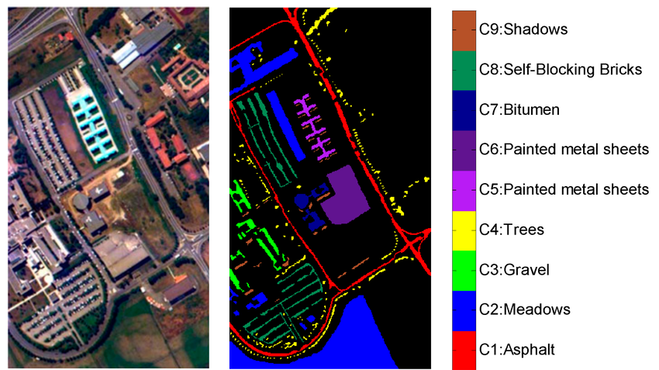
Data Description of PAVIA UNIVERSITY
Spatial Characteristics:
  Dimensions: 610 pixels x 340 pixels
  Spatial Resolution: 1.3 meters per pixel
Spectral Characteristics:
  Total Spectral Bands: 115
  After discarding 12 most noisy bands the set contains 103 bands
Ground Truth Information:
  Classes: 9 land cover types
Challenges:
  High dimensionality leading to computational complexity.
  Limited training samples for certain classes.
  Presence of noisy or missing data affecting classification accuracy.
Figure 3: Pavia University , Original Image (left), ground truth (middle) and label category (right)

Slide 7
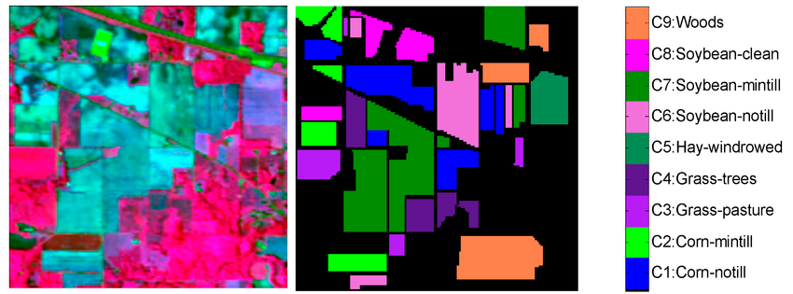
Data Description of INDIAN PINES
Spatial Characteristics:
  Dimensions: 145 pixels x 145 pixels
  Spatial Resolution: 20 meters per pixel (after dimension reduction)
Spectral Characteristics:
  Total Spectral Bands: 220
  After discarding 20 water absorption bands: 200 bands remained
Ground Truth Information:
  Classes: 16 land cover types
Challenges:
  Limited number of samples for some classes can adversely impact classification performance.
  The overlapping spectral signatures can complicate segmentation and classification tasks.
Figure 4: Indian Pines, Original Image (left), ground truth (middle) and label category (right)

Slide 8
Related Work on Hyperspectral Band Selection
We will briefly discuss about the three papers on hyperspectral band selection. Those three papers have proposed different methodologies and used different algorithms and mechanisms.
Three studies have successfully developed models that tackles the problems if dimensionality of hyperspectral image and also efficiently selects the most informative bands while disregard the noisy or redundant unnecessary bands.

Slide 9
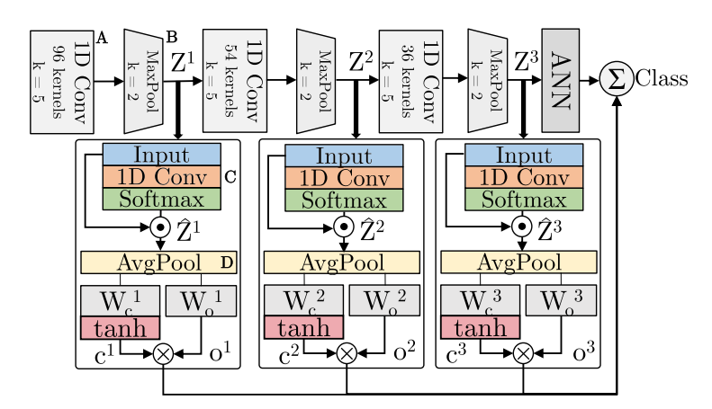
Lorenzo et al. (Hyperspectral Band Selection Using Attention-Based Convolutional Neural Network)
Key Idea:
  Integrates attention-based CNNs with anomaly detection to improve band selection in hyperspectral imaging.
Approach:
  Attention modules identify and prioritize informative spectral bands.
  Anomaly detection algorithm selects bands that are anomalous yet valuable.
Results:
  Reduces spectral bands by 14-19% (Salinas Valley dataset) and 9-27% (Pavia University dataset) without sacrificing accuracy.
  Enhances real-time applications, generalization, and scalability.
Impact:
  Interpretability improved via heatmaps showing the importance of selected bands.
  Useful for imbalanced datasets, enhancing minority class classification.
Figure 5: Attention Based CNN Architecture

Slide 10
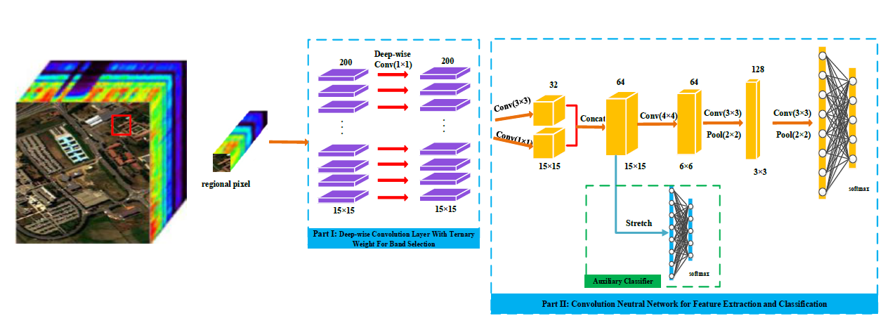
Feng et al. (Hyperspectral Band Selection Based on Ternary Weight Convolutional Neural Network)
Key Idea:
  A unified framework that integrates band selection, feature extraction, and classification using a ternary weight CNN (TWCNN).
Approach:
  Uses a ternary weight system (-1, 0, 1) for efficient band selection in the initial layer.
  End-to-end framework for seamless band selection, feature extraction, and classification.
Results:
  Achieves 95.9% accuracy using only 10 selected bands.
  Strong performance with 5% of the dataset for training.
  Faster than traditional methods due to avoidance of extensive random search techniques.
Impact:
  TWCNN is state-of-the-art, improving classification efficiency and reducing complexity compared to filter-based methods.
Figure 6: TWCNN Architecture, Part I: Deep-wise convolution layer with ternery weight for band selection, Part II: CNN for feature extraction and classifier

Slide 11
Implementation
We have implemented Attention Based CNN as described by Lorenzo et al. having:
  2-Attention Module
  3-Attention Module
  4-Attention Module
We have generated heatmap for the selected bands.
Based on the confidence scores in the heatmap bands are selected using Elliptical Envelope algorithm.
We trained the model on the selected bands and find out that the accuracy score wasn’t dropping abruptly.

Slide 12
Implementation
We have implemented the Ternary Weight CNN as described by Feng et al. is this paper.
  We applied ternary weight system in the initial layers which allows the model to assign a weight of -1 to unimportant bands, 0 to unused bands, and 1 to selected bands.
  There are two loss function used while training the model:
    Main loss (for spectral information)
    Auxiliary loss (for spatial information)
  We evaluated the TWCNN method using the Indian Pines dataset, which is widely used for hyperspectral image classification.

Slide 13
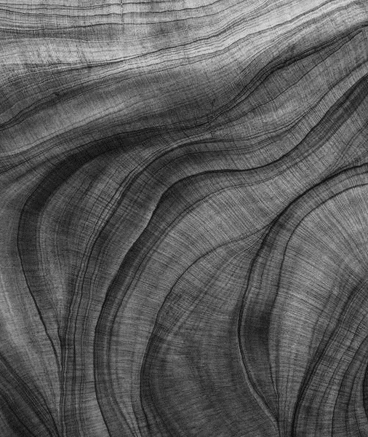
Results

Slide 14
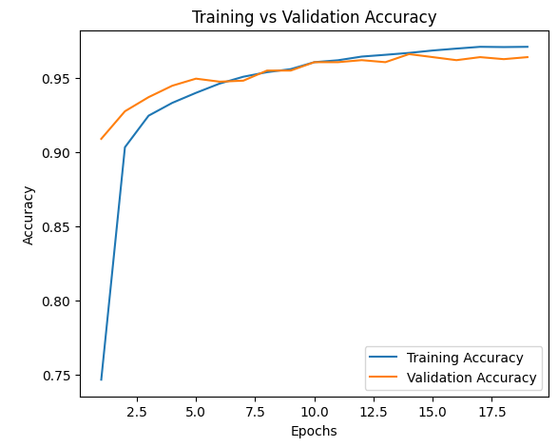
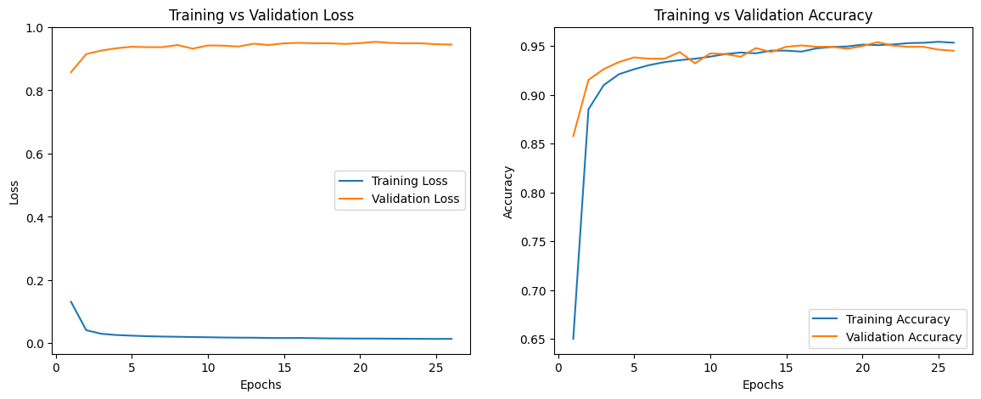
Accuracy Before and After Band Selection
(Attention CNN-3) (Salina Valley)
Figure 8: Training and Validation Accuracy Before(Left) and After(Right) Band Selection

Slide 15
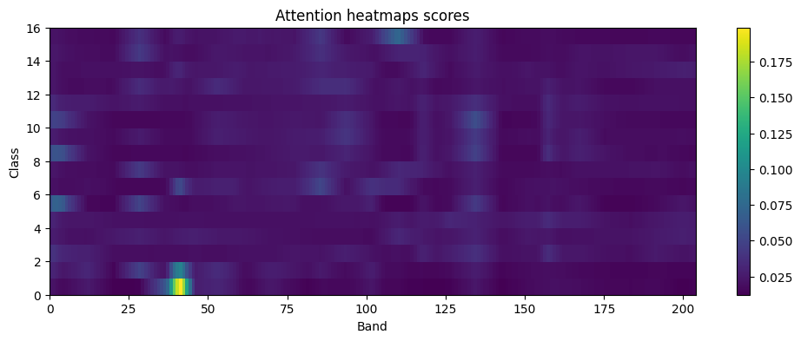
Attention Heatmap (Salina Valley)
The number of selected bands are 19 out of 204 (i.e, 0, 1, 2, 3, 28, 38, 39, 40, 41, 42, 43, 85, 86, 131, 132, 133, 134, 135, 136)
Accuracy dropped from 96.71% to 95.33%.
Figure 9: Attention Heatmap

Slide 16
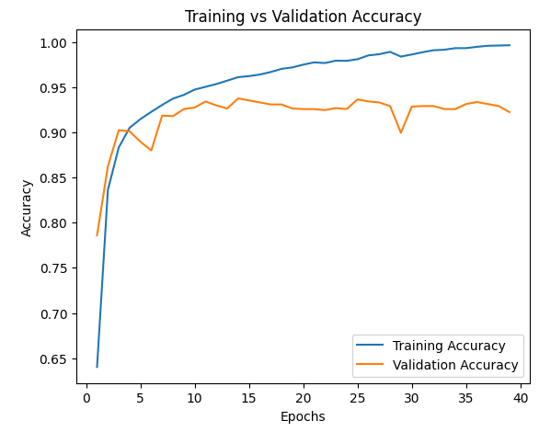
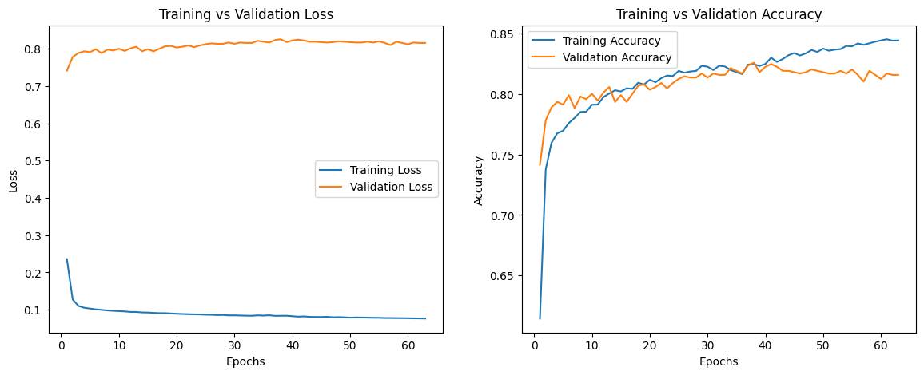
Accuracy Before and After Band Selection
(Attention CNN-3) (Pavia University)
Figure 10: Training and Validation Accuracy Before(Left) and After(Right) Band Selection

Slide 17
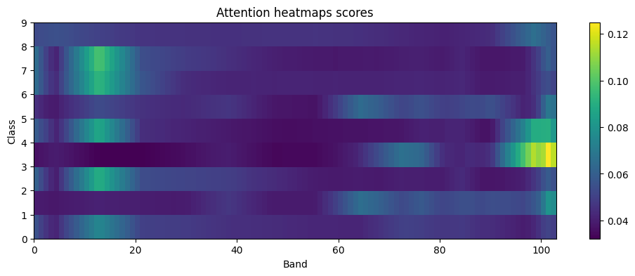
Attention Heatmap (Pavia University)
The number of selected bands are 11 out of 103 (i.e, 10, 11, 12, 13, 14, 15, 98, 99, 100, 101, 102).
Accuracy dropped from 93.9% to 81.6%.
Figure 11: Attention Heatmap

Slide 18
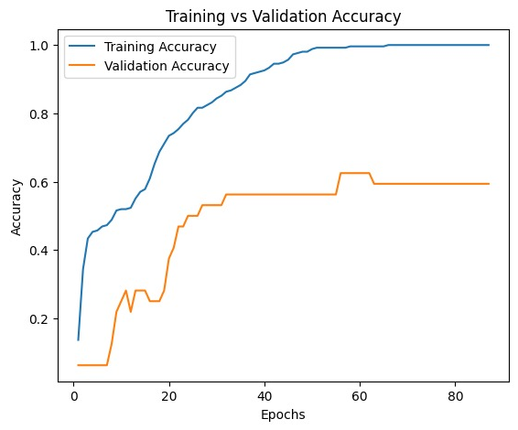
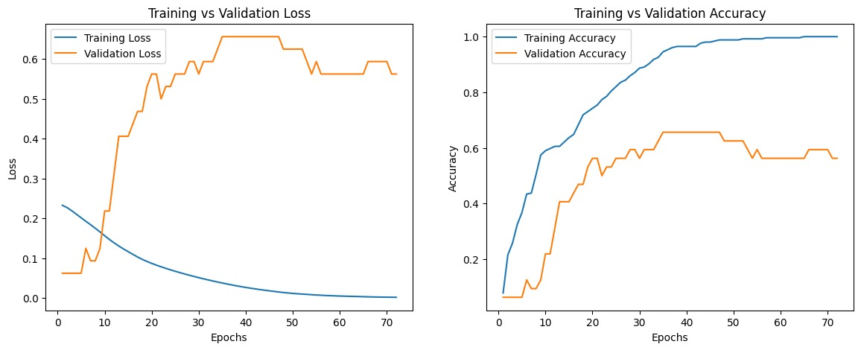
Accuracy Before and After Band Selection
(Attention CNN-3) (Indian Pines)
Figure 12: Training and Validation Accuracy Before(Left) and After(Right) Band Selection

Slide 19
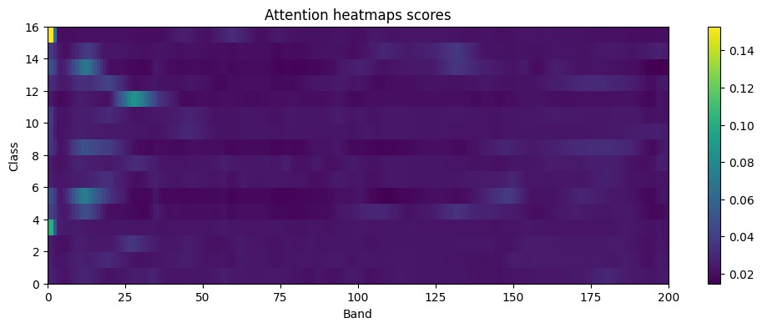
Attention Heatmap (Indian Pines)
Figure 13: Attention Heatmap

Slide 20
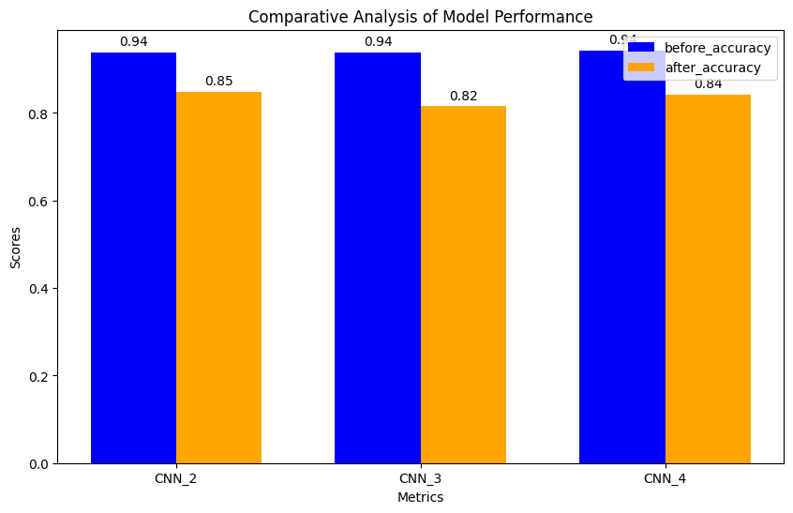
Comparison of Accuracy
(Attention CNN – 2,3,4)
Figure 14: Accuracy comparison of Attention Module CNNs before and after band selection on Pavia

Slide 21
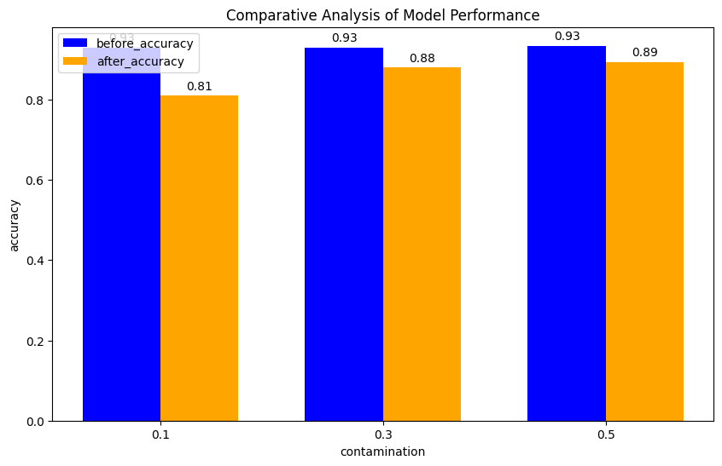
Contamination Comparison on
Attention CNN-3
Figure 15: Accuracy Comparison of different contamination rate before and after band selection on Pavia University Dataset

Slide 22
TWCNN
We have implemented the code as described using the ternary weight in the initial layers.
  Problems:
    Loss function not changing.
  We have tried different loss functions.
  We have tried changing the different model parameters.
Figure 16: Cost Function

Slide 23
Proposed Improvements
We have achieved high accuracy of 96% on Salina Valley dataset using attention based cnn which is better than the described SOTA (94%).
We tried fine tune the proposed parameters and experimented with different values to observe the change:
  We have changed the optimizer to AdamW and find changes in accuracy of the attention based cnn model.
    There has been a gain of 1.5% in accuracy.
  We have changed the learning rate from 0.001 to 0.0001.
  We have also experimented with different contamination rate (lambda).

Slide 24
Thank you

